Slide 1
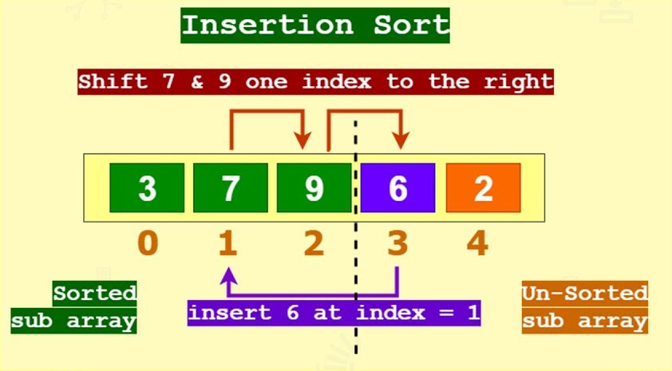
M02 L06 2D
TDD and Sort 1D Array Algorithms

Slide 2
Today
Check In
GE M01 - Questions follow CS2050 Agile Software Development_.pptx
Quiz moved to Sept 18th to give time for me to give feedback on GE and for you to get help
Goals
Implement and compare sorting algorithms on 1D arrays.
Set Up
Create a project for CS2050M02
Download SelectionSortTDD.java
Drag and drop file onto your project name
Commit and push

Slide 3

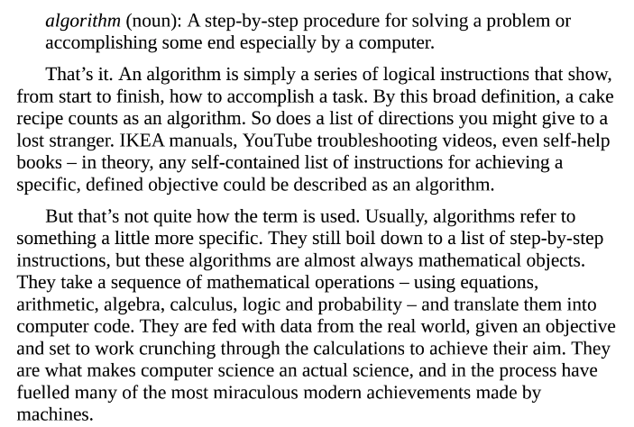
Algorithms: Digging Deeper
"You can’t just build an algorithm, put it on a shelf and decide whether you think it’s good or bad completely in isolation. You have to think about how that algorithm actually integrates with the world that you’re embedding in."
Majority of algorithms will be built to perform a combination of these categories
Prioritization: making an ordered list
Classification: picking a category
Association: finding links
Filtering: isolating what’s important
Take UberPool, for instance, which matches prospective passengers with others heading in the same direction. Given your start point and end point, it has to filter through the possible routes that could get you home, look for connections with other users headed in the same direction, and pick one group to assign you to – all while prioritizing routes with the fewest turns for the driver, to make the ride as efficient as possible.
HELLO WORLD - Ch. 1

Slide 4
Two General Approaches to Algorithms
Rule-based Algorithms: Their instructions are constructed by a human and are direct and unambiguous. You can imagine these algorithms as following the logic of a cake recipe.
Step one: do this.
Step two: if this, then that. That’s not to imply that these algorithms are simple – there’s plenty of room to build powerful programs within this paradigm.
Machine-learning algorithms: These are inspired by how living creatures learn. To give you an analogy, think about how you might teach a dog to give you a high five.
You don’t need to produce a precise list of instructions and communicate them to the dog. You give the machine data, a goal and feedback when it’s on the right track – and leave it to work out the best way of achieving the end.

Slide 5


Accountability in Coding - Why Testing Matters
When I first found this video in 2016 I shared with my students and have been following Dr. Joy Buolamwini’s work since Joy Buolamwini: How I'm fighting bias in algorithms
Then this came out right before I showed it: Check out NPR September 4, 2021 Facebook Apologizes For "Primates" Label On Video Of Black Men
Resources you might find interesting
Coded Bias - This documentary investigates the bias in algorithms. I was fortunate to be a part of a film screening where the director Shalini Kantayya was there to answer questions.
Unmasking AI - I am currently reading Joy’s book now
The Algorithmic Justice League

Slide 6
Sorting Algorithms
0 | 1 | 2 | 3 | 4 | 5
72 | 50 | 10 | 44 | 8 | 20
Put your name on paper.
How do you find the index of the largest number in the 1D array?
Brainstorm ideas on paper to come up with algorithms.
Draw the array on your paper
Write the steps as pseudocode that you think would work
Draw a different data set and see if your algorithm still works
After everyone has time to write their ideas you will discuss.

Slide 7
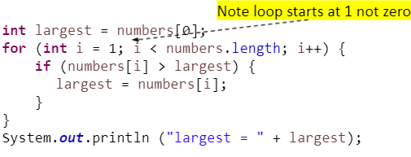
Sorting Algorithms
0 | 1 | 2 | 3 | 4 | 5
72 | 50 | 10 | 44 | 8 | 20
Find largest element

Slide 8
Sorting Algorithms
0 | 1 | 2 | 3 | 4 | 5
72 | 50 | 10 | 44 | 8 | 20
How do you sort an array from smallest to largest?
Brainstorm ideas on paper to come up with an algorithm.
Draw the array on your paper
Write a step and draw updated array
Look for a pattern to come up with the tasks and the algorithm
Draw different data set and see if your algorithm still works
After you each write down your ideas what are the different pieces to solving this problem? What algorithms you are thinking could be used? What are different arrays that might need to be considered to see if your algorithm works? How do you implement code?

Slide 9
Sorting Arrays
Sorting is a common task in computer programming. Many different algorithms have been developed for sorting.
Selection sort - Sorting algorithm in which each value, one at a time, is placed into its final sorted position in the list.
Bubble sort - Sorting algorithm in which values are repeatedly compared to neighboring elements in the list and their positions are swapped if they are not in the correct order relative.
Insertion sort - Sorting algorithm in which each value, one at a time, is inserted into a sorted subset of the entire list.
Quick sort - Will discuss when cover recursion
Merge sort - - Will discuss when cover recursion

Slide 10
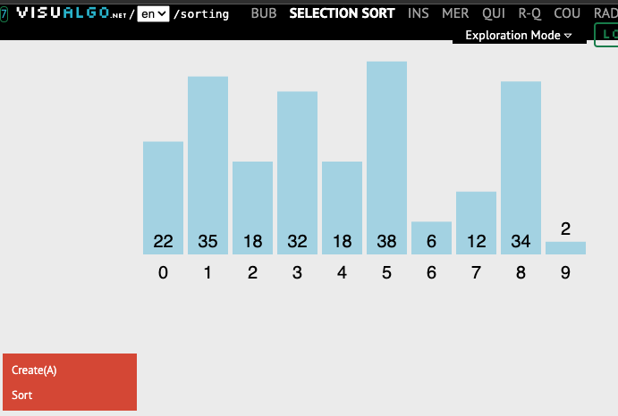
Selection Sort
In selection sort algorithm, we search for the lowest element and arrange it to the proper location. We swap the current element with the next lowest number. Explore how the selection sort works
Visualization of sorting algorithms - run each step by step
BUB
SELECTION SORT
INS
Click

Slide 11
Test Driven Development Summary
Following TDD helped us build the algorithm incrementally, reducing errors and improving maintainability.
Test Driven Development Summary
Break the problem into smaller parts
Design test cases to help understand logical thinking
Implement each algorithm and test before implementing next step.
Refactor following SRP and DRY

Slide 12
Test Driven Development and Design
As you add functionality to your system, you’ll be increasing the code base. The refactoring aids in redesign and you continually test the updates. We will follow this process to implement Selection Sort step-by-step focusing on manual testing with different arrays.
Varied unit tests and edge cases:
Test Case | precondition | Action | Expected Result (post condition )
Regular | {4, 2, 7, 1, 5} | selectionSort() | {1, 2, 4, 5, 7}
Empty | {} | selectionSort() | {}
Single Element | {5} | selectionSort() | {5}
Already Sorted | {1, 2, 3, 4, 5} | selectionSort() | {1, 2, 3, 4, 5}
Reverse Sorted | {9, 7, 5, 3, 1} | selectionSort() | {1, 3, 5, 7, 9}
Array with duplicates | {4, 2, 7, 2, 5} | selectionSort() | {2, 2, 4, 5, 7}

Slide 13
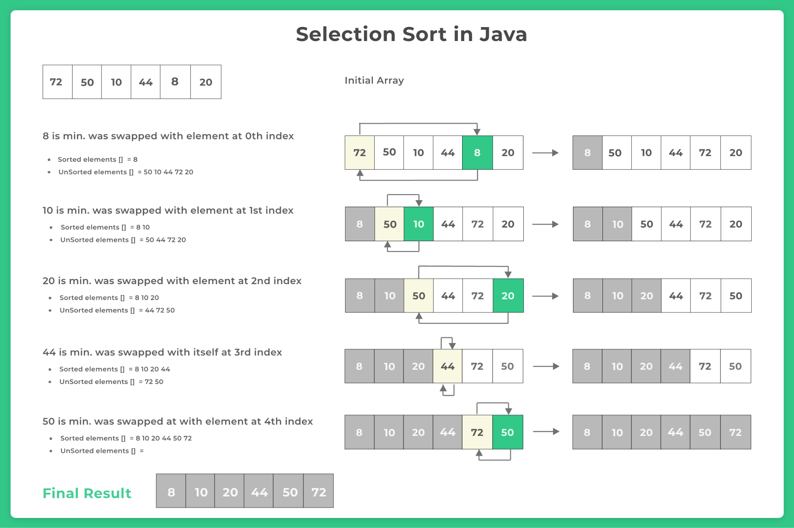
Visualization and Tasks
Selection sort - Sorting algorithm in which each value, one at a time, is placed into its final sorted position in the list. Break into tasks:
If smallest swap into correct position
Repeats until each position has been checked
0 | 1 | 2 | 3 | 4 | 5
72 | 50 | 10 | 44 | 8 | 20

Slide 14
Selection Sort Method Step 1: Algorithm to Find the Smallest Index
Write the method signature for sort method (arrays will hold integers)
What is a good name? What does the method need? What does the method return?
Write an algorithm to find the smallest index.
How can we ensure the function works correctly for different cases?
What happens if the array is empty?
Import SelectionSortTDD
Implement the first step of the sort method to find the smallest index and use debugger to test.
Remember to add comments for sections of code

Slide 15
Selection Sort Method Step 2: Algorithm to Swap
In the method next add a swap algorithm to swap the first index and the smallest
What happens if two indexes are the same?
Implement the code and test for all the test cases to swap. Add comments.

Slide 16
SelectionSort Method Step 3: Repeat
Repeat process
How do you repeat? Where do you
Implement the code to find smallest from the unsorted elements and swap. Add comments.
In selection sort algorithm, we search for the lowest element and arrange it to the proper location. We swap the current element with the next lowest number. Explore how the selection sort works
Selection Sort Code Animation
Selection Sort - Tpoint Tech

Slide 17
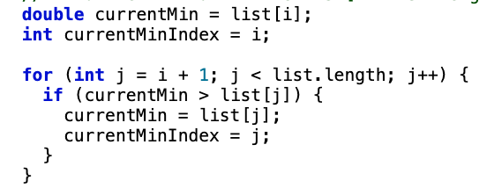

Selection Sort Steps
for (int i = 0; i < list.length - 1; i++) {
Outer for loop 0 to index 4
0
1
2
3
4
5
Inner for loop sublist
0 - 5
Inner 4 Finds smallest element in sublist
1 - 5
2 - 5
Swaps list[i] with list[currentMinIndex] unless i and currentMinIndex are the same
3 -5
4-5

Slide 18
Selection Sort Summary
Orders a list of values by repeatedly putting smallest value into its final position.
In place sorting – this means – sort is performed without creating a new list!
Combination of searching and sorting.
During each pass, the smallest element is moved to its proper location in the array.
Process to sort array into ascending order:
Find smallest element in the list
Swap smallest with 1st element
Looking at remaining elements, find next smallest element in the list
Swap that smallest with the 2nd element
Repeat until all values are in their correct locations

Slide 19

Problem with Large Array Sizes
Problem is that this is not suitable for large arrays
1st pass - finding the smallest value requires n – 1 comparisons
2nd pass - finding the 2nd smallest value requires n – 2 comparisons
….
(n-1) pass – finding the last smallest value requires 1 comparison
7 elements times 6 steps divided by 2
Divide by 2 since on average over all steps, ½ elements are still unsorted
If we replace 7 with n (or m in arithmetic series) we get
n X (n-1) X ½
½(n² - n)
This is an arithmetic series:
(n-1) + (n-2) + … + 2 + 1 = ½(n² + n) = O(n²)
Big O Notation - we will discuss in future lectures

Slide 20
Bubble Sort
Bubble sort is also called sinking sort
Smallest values bubble to the top, largest values sink to the bottom
Make several passes and on each pass the largest value is moved into its final position
Process
Compare successive neighboring pairs
If the pair is not in order, its values are swapped
If the pair is in order, the values remain unchanged
Make several passes through array until sorted
public static void bubbleSort(int[] array) {
for (int i = 0; i < array.length - 1; i++) {
for (int j = 0; j < array.length - 1 - i; j++) {
if (array[j] > array[j + 1]) {
int temp = array[j];
array[j] = array[j + 1];
array[j + 1] = temp;
}
}
}
}
Compares adjacent elements and swaps them if they are in the wrong order.
Repeats this process until the array is sorted.

Slide 21
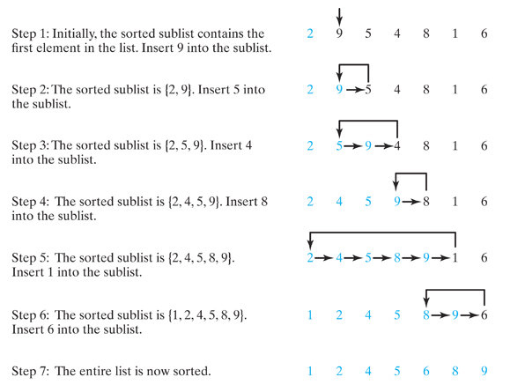
Explore Insertion Sort and TDD
Insertion Sort Animation
It always maintains a sorted sublist in the lower positions of the list.
Each new item is then inserted back into the previous sublist such that the sorted sublist is one item larger

Slide 22
Examine Pattern on Paper: Step 1
Write code for easiest case – add 1st element to sublist
2nd element is compared with the element before it and inserted in proper slot
Insert list[1] value into the list that contains list[0] so the list is sorted
Sublist list[0] = 4
Value to insert is 2
Case | Precondition | Postcondition
Regular | {4, 2, 7, 1, 5} | {2, 4, 7, 1, 5}
Empty | {} | {}
Single Element | {5} | {5}
Already Sorted | {1, 2, 3, 4, 5} | {1, 2, 3, 4, 5}
Reverse Sorted | {9, 7, 5, 3, 1} | {7, 9, 5, 3, 1}
Array with duplicates | {4, 2, 7, 2, 5} | {2, 4, 7, 2, 5}
4 | 2 | 7 | 1 | 5
What is the algorithm
Insert 4 into sublist
2 | 4 | 7 | 1 | 5

Slide 23
Examine Pattern on Paper: Step 2
Write code for easiest case – add 1st element to sublist
3rd element is compared with the elements before it and inserted in proper slot
Insert list[2] value into the list that contains list[0..1] so the list is sorted
Sublist is list[0..1] = [2, 4]
Value to insert is 7
Case | Precondition | Postcondition
Regular | {4, 2, 7, 1, 5} | {2, 4, 7, 1, 5}
Empty | {} | {}
Single Element | {5} | {5}
Already Sorted | {1, 2, 3, 4, 5} | {1, 2, 3, 4, 5}
Reverse Sorted | {9, 7, 5, 3, 1} | {5, 7, 9, 3, 1}
Array with duplicates | {4, 2, 7, 2, 5} | {2, 4, 7, 2, 5}
2 | 4 | 7 | 1 | 5
What is the algorithm
Insert 7 into sublist
2 | 4 | 7 | 1 | 5

Slide 24
Write Algorithm using Pseudocode
Run through test cases
Step | Array State | Explanation
Initial | {4, 2, 7, 1, 5} | Unsorted array
Step1 | {2, 4, 7, 1, 5} | 2 is inserted before 4
Step 2 | {2, 4, 7, 1, 5} | 7 is already in correct place
Step 3 | {1, 2, 4, 7, 5} | 1 moves to correct position
Step 4 | {1, 2, 4, 5, 7} | 5 moves to correct position

Slide 25
Does this algorithm work?
public static void insertionSort(int[] array) {
for (int i = 1; i < array.length; i++) {
int key = array[i];
int j = i;
while (j > 0 && array[j - 1] < key) {
array[j] = array[j - 1];
j--;
}
array[j] = key;
}
}
Case | Precondition | Postcondition
Regular | {4, 2, 7, 1, 5} | {1, 2, 4, 5, 7}
Empty | {} | {}
Single Element | {5} | {5}
Already Sorted | {1, 2, 3, 4, 5} | {1, 2, 3, 4, 5}
Reverse Sorted | {9, 7, 5, 3, 1} | {1, 3, 5, 7, 9}
Array with duplicates | {4, 2, 7, 2, 5} | {2, 2, 4, 5, 7}

Slide 26
Bubble Sort
Bubble sort is also called sinking sort
Smallest values bubble to the top, largest values sink to the bottom
Make several passes and on each pass the largest value is moved into its final position
Process
Compare successive neighboring pairs
If the pair is not in order, its values are swapped
If the pair is in order, the values remain unchanged
Make several passes through array until sorted
Bubble Sort Animation by Y. Daniel Liang

Slide 27
Preparation
Go to canvas for today’s participation and preparation

